Slide 1
Faculty Senate Meeting
September 10, 2020
https://umsystem.zoom.us/j/98708669720?pwd=UGJSajZYT1ZFbjJtNnY5eEgrTHJ3dz09
Meeting ID: 987 0866 9720
Password: 091020

Slide 2
Agenda
Call to Order and Roll Call
K. Dolan, Secretary

Slide 3
Agenda
Approval of Minutes
July 2, 2020

Slide 4
Agenda
III. Campus Reports
  A. Staff Council, A. Kossuth

Slide 5
Agenda
III. Campus Reports
  B. Student Council, L. Hierlmeier

Slide 6
Student Council
Lawrence Hierlmeier
  COVID Open Forum in the works
  New Membership Form
  S&T Provost Search Committee

Slide 7
Agenda
IV. President’s Report
S. Raper

Slide 8
President’s Report
Dr. Stephen Raper, Faculty Senate President

Slide 9
Faculty Senate Officers 2020 -2021
Past President – Steven Corns (IFC member)
President – Stephen Raper (IFC member)
President Elect – Kelly Holman (IFC member)
Kathleen Sheppard – Parliamentarian
Kathryn Dolan - Secretary

Slide 10
COACHE Survey
Open forum: September 23, 2020 (9:00 – 11:00 a.m.)
Dr. Wayne R. Jones – Chief Institutional Research Officer
Should have results at future Faculty Senate meeting

Slide 11
Intercampus Faculty Cabinet (IFC)
IFC Retreat, August 4 – 5 – Annual Retreat
  Discussion and presentation from Beth Chancellor – Information Technology
    Variety of issues including email and strategic planning priorities
  eLearning updates – Matt Gunkel
  General budget presentation – Ryan Rapp
  CRR 320.035 Promotion & Tenure; CRR 310.060 Dismissal for Cause; IFC/ISC

Slide 12
Intercampus Faculty Council (IFC)
IFC regular meeting – 4 September
  Revisit mid-career faculty development
  Human Resources – Marsha Fischer –open enrollment Oct 26 – November 6, very modest premium increases
  Anticipate CRR 320.035 Promotion & Tenure President approval on September 8th. Distributed September 9.

Slide 13
Faculty Senate Summer
June 11 – Regularly Scheduled Meeting
  By-Laws revisions currently in progress and nearing conclusion
  Discussion of Administrative Review
  AF&S brief on S/U grading
July 02 – Special Meeting
  Discussed and adopted resolution concerning merger of UM System President with University of Missouri Chancellor
  Resolution submitted to BOC

Slide 14
Request for Input E-Learning
Input desired from Caprice Moore Interim VP Global Learning
“What would you like to know about UM System eLearning initiative?”
“Before Covid-19 did you teach distance courses?”

Slide 15
Request for Task Force Membership
Interim Provost Roberts requests faculty participation on task force to “study and make recommendations on issue or organizational structure and process”
Request sent to Standing Committee Chairs

Slide 16
Faculty Senate Resolution for Dr. Steven Corns
Whereas Professor Steven Corns has served the Faculty Senate of the Missouri University of Science and Technology as Secretary (2016-2017), Parliamentarian (2017-2018), President-Elect (2018-2019) and President (2019-2020); and
Whereas, as an Officer of the Faculty Senate, Professor Steven Corns has demonstrated focused, collegial, consistent, balanced and intelligent hard work in support of faculty rights and interests; and

Slide 17
Faculty Senate Resolution for Dr. Steven Corns
Whereas, Professor Steven Corns helped to guide the university through a time of transition involving a new Chancellor, Interim Provost, and senior leadership changes, as well as significant budgetary constraints; and
Whereas, Professor Steven Corns inspired and motivated the faculty with resilient leadership during the sudden and challenging crisis of the COVID-19 pandemic;

Slide 18
Faculty Senate Resolution for Dr. Steven Corns
Therefore, be it resolved that the Faculty Senate of the Missouri University of Science and Technology does hereby sincerely thank Professor Corns for every job well done and wish him continued success in his future endeavors.
Adopted this 10th day of September 2020 at the meeting of the Faculty Senate of Missouri University of Science and Technology.

Slide 19
Next-Motion by
Dave Westenberg

Slide 20
Motion to award Athletic Director Emeritus status
to Mark Mullin
Mark Mullin has expressed desire to receive emeritus status.
Prior to retiring on September 1, he served as UMR/S&T’s Athletic Director for 28 years.
He was a member of Faculty Senate throughout.
His tenure as Athletic Director was a period of great academic and athletic success of our student athletes.

Slide 21
Motion to award Athletic Director Emeritus status
to Mark Mullin
The process of awarding an academic emeritus title begins with a vote by departmental faculty.
Athletics is no longer an academic department.
Non-academic emeritus/emerita titles require that the individual’s contributions to the university be recognized as meritorious as recommended by vote of the faculty senate/council.
  Faculty Senate recognized Mark’s contributions with a resolution on April 16.

Slide 22
Motion
Whereas CRR 320.090 does not anticipate this specific situation be it resolved that, in the spirit of CRR 320.090, the Faculty Senate of the Missouri University of Science and Technology does request and recommend that Mark Mullin be granted the title Athletics Director Emeritus including all associated rights and responsibilities.”

Slide 23
CRR 320.090 Emeritus Designation
A. Rule—The procedure for granting the title of “Professor Emeritus”, “Associate Professor Emeritus” or “Curators Distinguished Professor/Teaching Professor Emeritus” shall originate with the retiring^{[1]} faculty member's department. The appropriate title shall be granted to any member of the full-time tenured or non- tenure track faculty with a ranked professorial title in good standing at the time of their retirement, when each of the following conditions have been met:
  Associate professor (15 yrs), Professor (5 yrs)
  Desire for Emerita/Emeritus status
  Meritorious contributions as determined by faculty vote
  Approval by Dean and Provost
[1] For purposes of this rule, retirement shall be defined as resignation from full-time employment with the University at the age of 55 or older.

Slide 24
CRR 320.090 Emeritus Designation
B. Administrators at the level of dean and above may be granted an emeritus title commensurate with their former positions (e.g., dean emeritus, provost emeritus). To be eligible, administrators must have held the rank of professor or associate professor at the university for at least five years, have indicated a desire to receive the emeritus title, and made contributions to the university recognized as meritorious as recommended by vote of the faculty senate/council. The recommendation will be transmitted to the chancellor who makes a final decision, or in the case of the chancellor’s candidacy, to the president.

Slide 25
CRR 320.090 Emeritus Designation
C. Exceptions
A retiring member of the faculty who is not covered by the above rule who has been recommended by majority vote of the eligible departmental voting faculty at the rank of professor or associate professor and by the dean of the faculty member's school or college, and, by the provost may be awarded an emeritus designation by the chancellor when the faculty member
  has retired in good standing;
  has indicated the desire to receive emeritus status; and
  their contributions to the department and the university are recognized as exceptionally meritorious.

Slide 26
CRR 320.090 Emeritus Designation
D. Members of the faculty who have received the title of emeritus shall continue as members (non-voting, except with regard to votes on promotion and tenure recommendations by qualified professors emeriti who are serving on a special promotion and tenure committee or committees related to procedures for review of faculty performance under circumstances described in section 320.035.A.1.c and section 320.035.A.1.d or section 310.015.B.1.d.(1).(a) and section 310.015.B.1.d.(1).(b) respectively of the Collected Rules and Regulations) of the campus faculty; and their names shall appear in the list of Officers of Instruction and Administration in the university catalog. Persons retiring from the university who do not receive the title of emeritus shall receive no title designation.

Slide 27
Faculty Senate Resolution from April 2020
Whereas Mark Mullin has served the Faculty, Staff, Students, and Alumni of the Missouri University of Science and Technology as Athletics Director from 1992 to 2020; and
Whereas, as Director of Miner Athletics, Mark Mullin has led Miner Athletics to fourteen conference championships, ten additional titles, over seventy NCAA championship competition appearances with nearly one hundred student athletes named academic all-americans, nearly 80 all-americans and over 350 all-conference selections; and

Slide 28
Whereas, Mark Mullin‘s leadership skills and diligence have led to many facility improvements for Miner Athletics including construction of the student recreation center, multiple renovations of Allgood-Bailey Stadium, construction and expansion of fitness center facilities, multiple renovations of the Gale-Bullman multi-purpose building including Gibson Arena; and
Whereas Mark Mullin has served diligently as a Senator of the Faculty Senate of the Missouri University of Science and Technology (1992-2020)
Therefore, be it resolved that the Faculty Senate of the Missouri University of Science and Technology does hereby sincerely thank Mark Mullin for every job well done and wish him continued success in his future endeavors. Adopted this 16th day of April, 2020, at the meeting of the Faculty Senate of Missouri University of Science and Technology.

Slide 29
Agenda
V. Administrative Reports
A. Chancellor’s Report
M. Dehghani

Slide 30
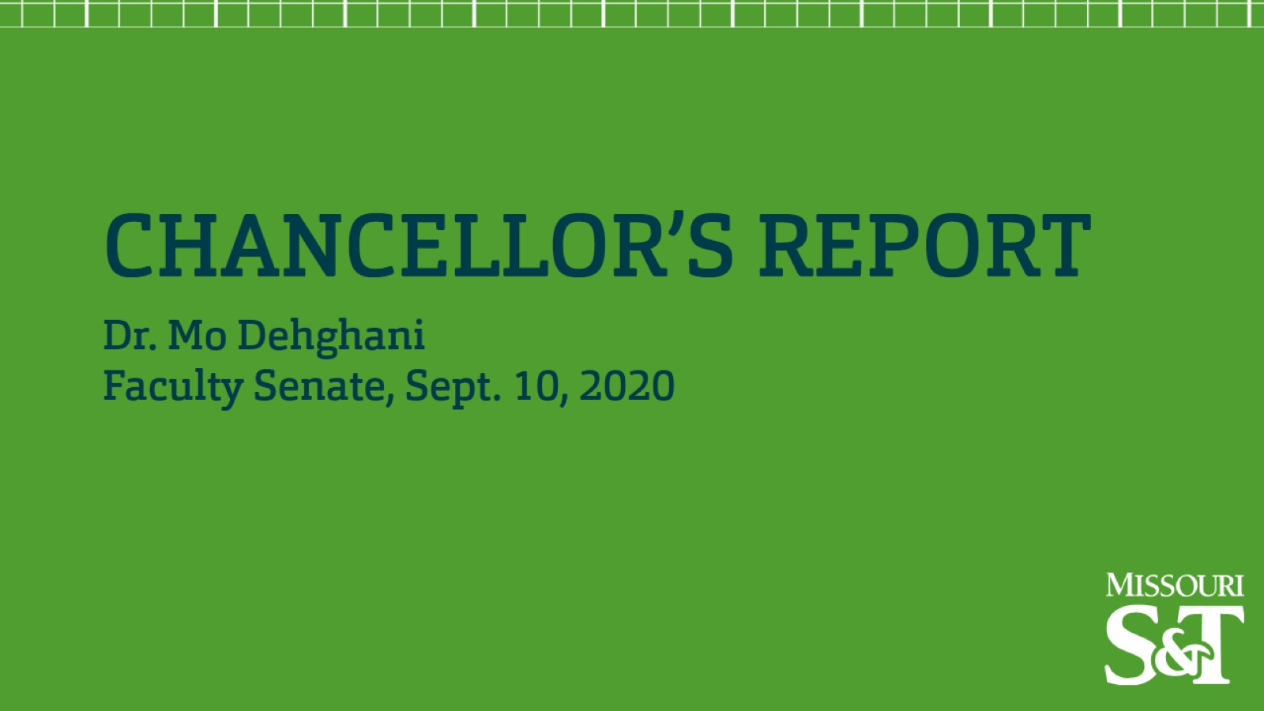

Slide 31
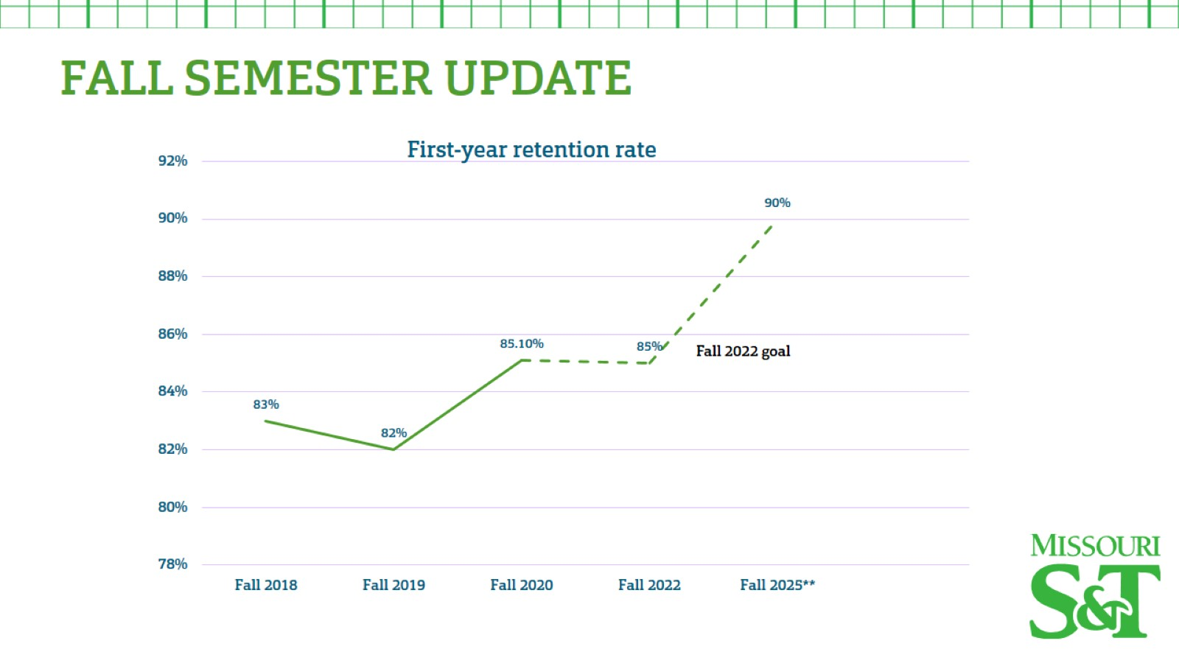

Slide 32
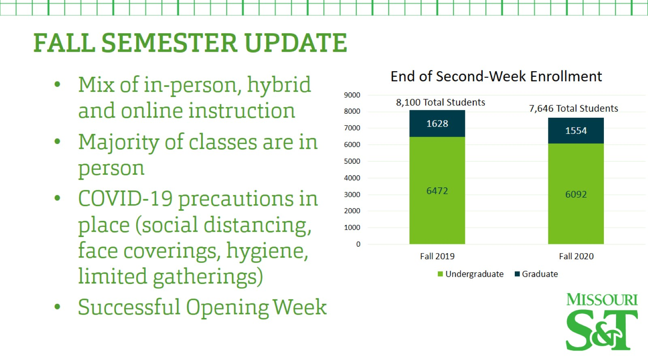

Slide 33
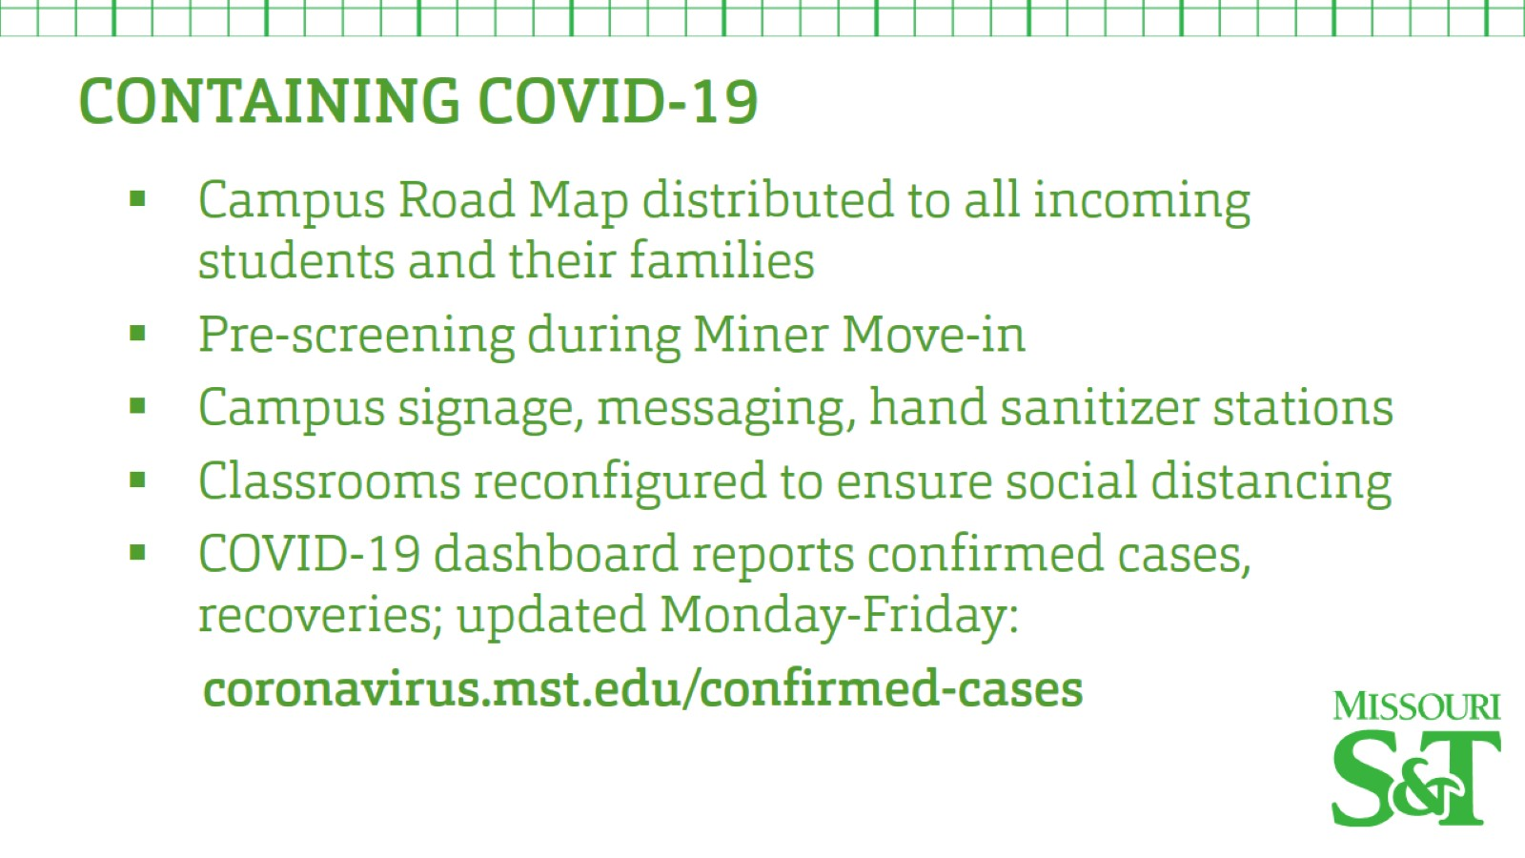

Slide 34
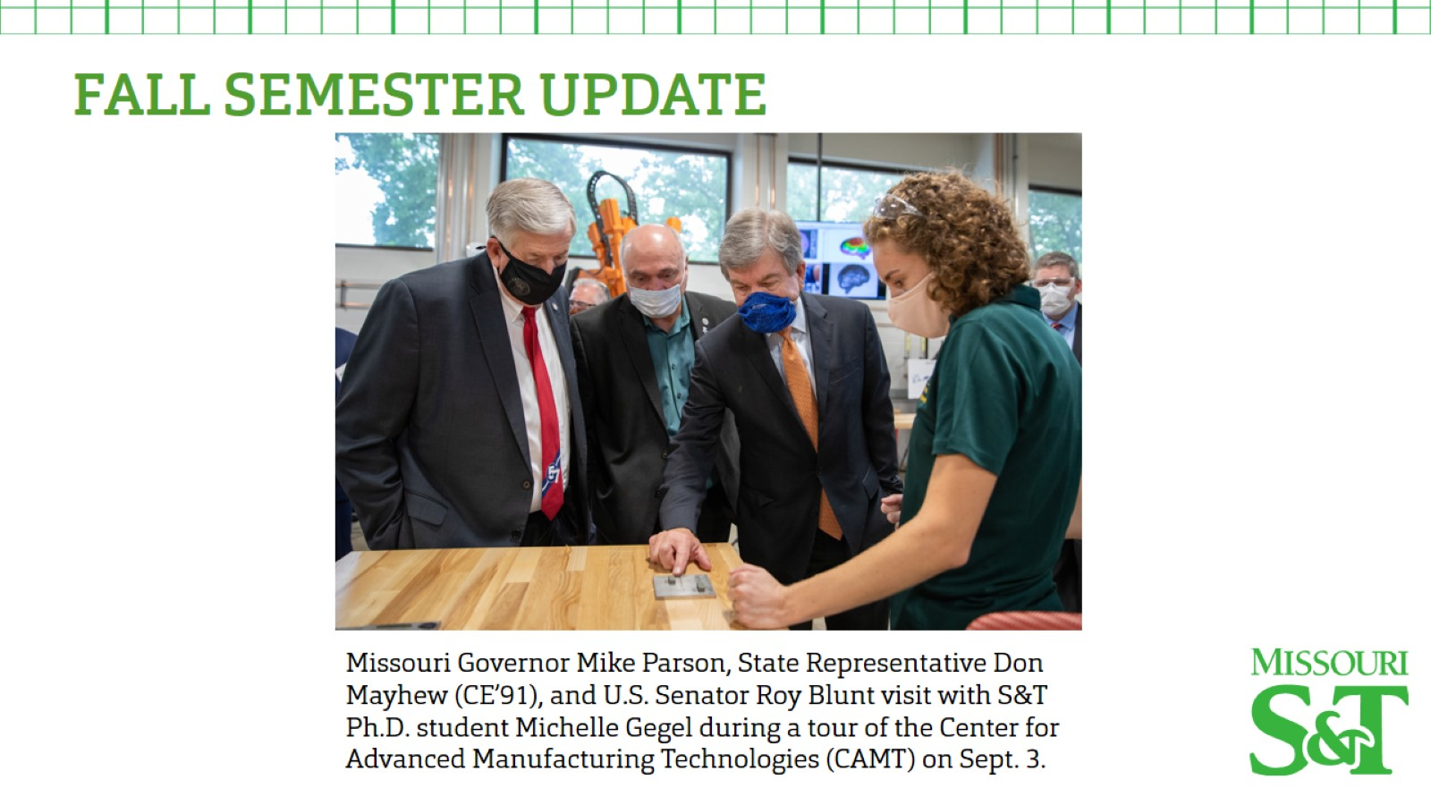

Slide 35
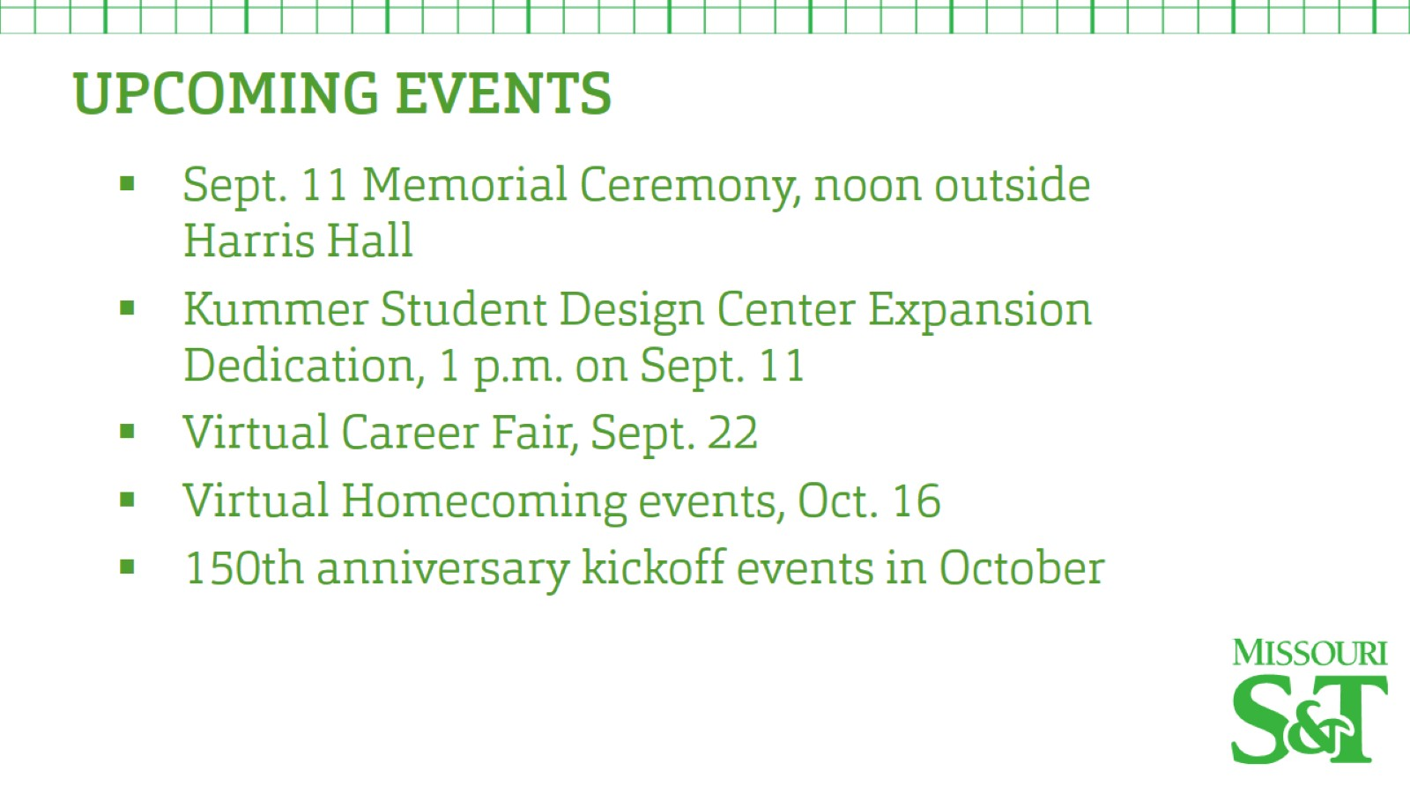

Slide 36


Slide 37
Agenda
V. Administrative Reports
B. Provost’s Report
S. Roberts

Slide 38
Steve Roberts
Interim Provost and Executive Vice Chancellor of Academic Affairs
Report to Faculty Senate
September 10, 2020

Slide 39
Status of Fall Semester of 2020
Academic calendar remains unchanged. However, the deadline for 100% refund was extended by one week, to Friday, September 4.
1,553 unique courses/course sections are being taught.
  50% in-person, 20% hybrid, and 30% online. 2/3rds of online courses are synchronous.
  This ratio of modalities was an emergent property of social distancing guidelines, available physical teaching spaces, instructor circumstances, and collaboration between faculty, department chairs, the registrar, and the Learning Transition Team.
ALL COURSES AND INSTRUCTORS SHOULD BE PREPARED TO TRANSITION TO REMOTE INSTRUCTION AT ANYTIME, DEPENDING ON PREVAILING COVID-19 CONDITIONS.

Slide 40
Spring 2021 Course Schedule
Is being built off of the Spring 2020 course schedule.
Same assumptions as in Fall 2020. Times, places, and modes of courses are being scheduled according to prevailing guidelines for social distancing, capacities of teaching spaces, and circumstances of individual faculty.
Faculty, department chairs, the registrar and the Learning Transition Team will collaborate to build out the Spring 2021 schedule, as they did the Fall 2020 schedule.
The final schedule of course times, places, and modes will again be an emergent property of these considerations.

Slide 41
Improving student success
Undergraduate retention and graduation rates.
  Direct engagement of unregistered students
  More advisors in Freshman Advising Center
  Better real-time screening for students who are at risk in terms of engagement, wellness, academics, and finances
  Graduation and Retention Committee Report
    Improve student sense of community and belonging through engagement in social and academically-focused activities.
    Formalize the university’s commitment to well-being
    Organize, centralize, and increase access to existing campus resources
    Early identification of and intervention for students most at risk
    Continue focus on recruitment and retention of highly qualified students and on rigorous academics

Slide 42
Improving student success, cont.
Undergraduate retention and graduation rates.
  Special focus on 22 “barrier” courses characterized by high enrollments and DFW rates of ~20% or greater.
    1000 to 4000-level courses
    Math, Physics, History, Economics, GGPE, CBE, Chem, Comp Sci, ECE, CArEE, MAE
    4 AY’s and 3 summers: AY14-15, SU15, AY15-16, SU16, AY16-17, SU17, AY17-18
    42,983 enrolled and 11,363 DFW’s in these courses. DFW = 26.5%
    Departments are developing plans to improve student success in these courses, for implementation in Spring 2021.
    IS NOT A CALL TO LOWER ACADEMIC STANDARDS IN THESE COURSES
    IS A CALL TO CREATE A MORE EFFECTIVE LEARNING EXPERIENCE
    Strategies for improving student success:
      Reassessment of prerequisites
      Preparatory programs
      Peer-learning and tutoring
      Revised teaching strategies
      Revised assessment strategies
      Implementation or revision of intervention strategies

Slide 43

Questions?

Slide 44
Agenda
VI. Reports of Standing Committees
A. Budgetary Affairs
M. Fitch

Slide 45
Budgetary Affairs Committee
Sept 10, 2020
Referrals
Departmental reorganization
Distance education production
Continuing referrals:
Report on the “big picture balance sheet”
Current and next FY budget

Slide 46
School on Earth and Minerals
Geosciences and Geological and Petroleum Engineering
Mining and Nuclear Engineering
Nuclear Engineering and Radiation Science
Chair: Borrok
Chair: (Awauh-Offei, Alajo)
Bai
Dunn-Norman
Flori
Imqam
Wei
Cawlfield
Gertsch
Grote
Maurer
Rogers
Smith
Bunch (Instr)
Eckert
Gao
Hogan
Liu
Locmelis
Mulligan
Oboh-Ikuenobe
Obrist
Wronkiewicz
Yang
Seeger (Lect)
Alajo
Alam
Castaño
Graham
Mueller
Schlegel
Usman
Frimpong
Awuah-Offei
Perry
Alagha
Xu
Sherizadeh
Johnson
Buchely
Lauck
Robertson
Sansone
Phelps
Alobaidan
Casey
Russel
Taber
[Open position]
Taylor
Phelps
Davis

Slide 47
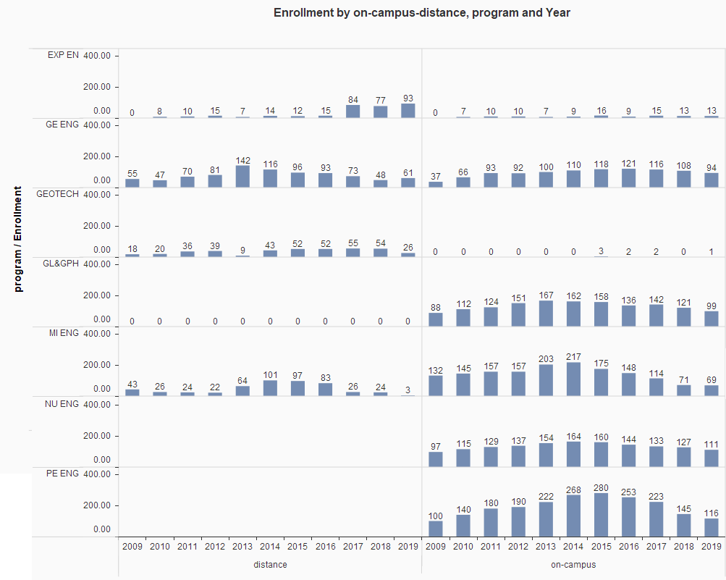

Slide 48
Financial
No change in personnel proposed
Administrative costs: add NERS department chair position, summer month for associate chairs likely, subtract two directors in MNE. Cost similar to routine faculty and administrative turnover.
No change in enrollment predicted, most programs have continuing decline

Slide 49
Distance Education
Tuition and fees charged by degree program, not delivery.
Approx. per credit hour charges:
Nonresident grad $1500
Distance grad 1200 (Not increased this year)
Res grad/military 700
Nonresident UG 1200
Resident UG 550
Distance UG 550

Slide 50
Distance Education
Producers from Global to IT
IT laid off producers or transitioned to other duties
High costs attributed to randomness of course production location and time
Dedicated control rooms and production equipment unable to be used by faculty (e.g. classroom microphones and front cameras off)
Decisions made did not include familiarity with distance education, focus on COVID-19, will evaluate
System may be trying to take over S&T distance

Slide 51
S&T Totals, FY 2020
Residence halls, food, etc.
Must use as specified
Useable money

Slide 52
Budget: where we thought we were

Slide 53
Current fiscal year planned:
Revenue projection
Freshmen flat (?), student total down, higher % resident $ -9.4
State appropriation (withholding possible) - 0.8
Other (auxiliary, etc.) - 1.5
Increased cost expectations
No merit raises = 0% raise pool $ 0.0
Benefit cost increases 1.2
P&T, NTT promotion, PTR awards 0.235
Minimum wage increase 0.3
Golf Team (currently cost not rate) 0.2
IT, insurance, utilities, building repair 0.7
Sum $14.3 = 9% cut
Cut mandate from UM System was 12.5%

Slide 54
Revenue Changes
State funding declining; majority of our income is tuition
Tuition declining not because of student numbers but mix, fewer paying international/out-of-state
Federal COVID relief downplayed ($2.6 million to cover expenses not shown)

Slide 55
Cost Changes
Employees are 74% of costs
Benefit cost increases average 4% annual
Chancident Choi restricting spending: hires require chancellor approval; no pay changes, increases, or job reclassifications; no travel or food purchase.

Slide 56
Budget connects to “in person classes”
Close dorms and food = $15 MM loss
lose ~$7 million in transfers into operating budget,
offset by layoff most of res life,
have to pay bonds on residence halls ($6.4 MM) and some utilities ($1 MM)
(learning situation here may be better than home)
Tuition:
Some withdrawals/drops = partial refunds
Fewer students in spring = lower tuition and fee revenue
Students might demand refunds for loss of in-person quality; refunds on some services
Might System/State punish S&T for ‘shutdown’?

Slide 57
Good news
There is no good news
But plan for this year, FY 2021, conservative
  State allocated more $ than expected, -$0.8 MM planned, but allocation is no change [State revenue projected down 10% might cause withholding, 10% is -4.3 MM]
  Budget cut mandated by UM is 12.5%, but 9% is estimated reality

Slide 58
Agenda
VI. Reports of Standing Committees
B. Personnel
D. Westenberg

Slide 59
Merger of GGPE with Mining and Explosives,
Formation of Nuclear Engineering and Radiation Science
To consider the appropriateness of the proposed realignment, the personnel committee would like to have additional information on the following points
  Is this new program a targeted area for growth and investment.
  Was there external consultation regarding need for merger and structure of merged program?
  How will the new program promote interdisciplinary collaboration and avoid silos?
  Was this the only option considered?
  What happens if nothing is done?

Slide 60
Merger of GGPE with Mining and Explosives,
Formation of Nuclear Engineering and Radiation Science
Additional points
  What will be done to ensure equal representation by each degree program?
  What is being done to ensure a thoughtful process in making staffing decisions – i.e. making best use of staff talents rather.
    Are there benchmarks being used to define appropriate staffing levels?

Slide 61
Agenda
VI. Reports of Standing Committees
Curricula Committee
S. Raper

Slide 62
CCC Calendar
CCC Meetings
  12 August
  7 October (upcoming)
Total Committee Activity
  10 Degree change request (DC forms)
  20 Course change requests (CC forms)
  10 Experimental course requests (EC forms)

Slide 63
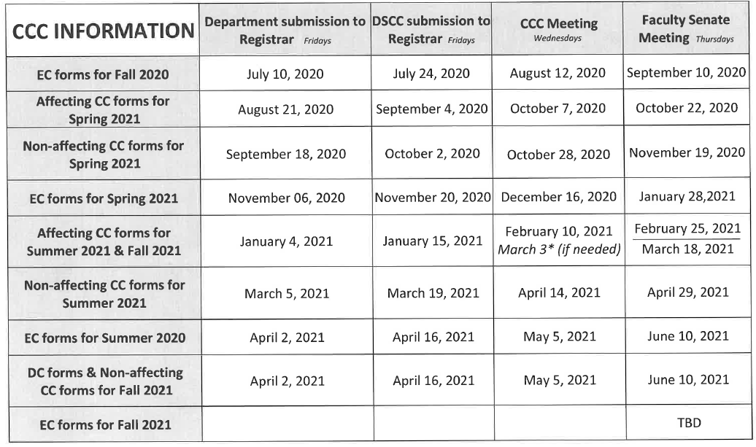
CCC Calendar

Slide 64
Degree Program Changes (DC) Requested
  File: 145.11 BIOINFO-MI : Bioinformatics Minor
  File: 11.6 BUS&MS-MI : Business Minor
  File: 28.65 CMP SC-BS : Computer Science BS
  File: 40.6 E&S COM-MI : Elect & Social Commerce Minor
  File: 155.55 EL ENG-BS : Electrical Engineering BS
  File: 50.7 ENTPRNS-MI : Entrepreneurship Minor
  File: 138.12 MGMT-MI : Management Minor
  File: 190.1 MUSIC-MI : Music Minor
  File: 359 PROPOSED : Aggregates Management CT
  File: 335.6 SFTYENG-CT : Safety Engineering

Slide 65
Course Changes (CC) Requested
  File: 4720 BUS 1414 : The Inclusive Workplace
  File: 4406.8 BUS 5230 : Financial Statement Analysis
  File: 507.10 BUS 5360 : Business Operations
  File: 2417.1 CER ENG 5230 : Glass Science And Engineering
  File: 4279.22 CHEM ENG 3111 : Numerical Computing in Chemical and Biochemical Engineering
  File: 4501.6 CHEM ENG 6180 : Advanced Applications of Computational Fluid Dynamics
  File: 938.1 COMP SCI 4010 : Seminar
  File: 1668.1 ERP 4610 : Customer Relationship Management in ERP Environment

Slide 66
Course Changes (CC) Requested
  File: 2527.3 ERP 6610 : Advanced Customer Relationship Management in ERP Environment
  File: 2566.8 FINANCE 5160 : Corporate Finance II
  File: 2190.10 FINANCE 5260 : Investments I
  File: 4499.6 FINANCE 5310 : Financial Technology and Analytics
  File: 920.10 IS&T 4654 : Introduction to Web Design and Digital Media Studies
  File: 2390.2 IS&T 5680 : Digital Media Development and Interactive Design
  File: 445.4 IS&T 6654 : Advanced Web Design and Digital Media Studies

Slide 67
Course Changes (CC) Requested
  File: 1614.6 IS&T 6680 : Advanced Digital Web and New Media Development and Interactive Design
  File: 4724 MECH ENG 5539 : Modeling Across Scales in Computational Mechanics
  File: 2466.1 MUSIC 2111 : Individual Music Instruction III
  File: 1983.1 PET ENG 4631 : Applied Reservoir Simulation
  File: 79.3 PET ENG 6621 : Advanced Applied Reservoir Simulation

Slide 68
Curriculum committee moves for FS to approve the DC and CC form actions
Discussion: Questions or comments?

Slide 69
For Informational Purposes; No Senate Approval Required
Experimental Course (EC) Requests
  File: 4722 CIV ENG 6001.007 : Characterization and Modeling of Cement-Based Materials
  File: 4721 COMP ENG 6001.006 : Adaptive Resonance Theory and Applications
  File: 4723 MECH ENG 5001.005 : Neuromechanics of Human Movement
  File: 4734 MUSIC 2001.004 : The Heart of Rock n' Roll
  File: 4715 STAT 5001.003 : Computational Bayesian Methods using Python

Slide 70
For Informational Purposes; No Senate Approval Required
Experimental Course (EC) Requests
  File: 4719 STAT 5001.004 : Design and Analysis of Clinical Trials
  File: 4717 STAT 5001.005 : Foundations of Statistical Learning
  File: 4718 STAT 5001.006 : Design and Analysis of Epidemiologic Studies
  File: 4716 STAT 5001.007 : Statistical Shape Analysis
  File: 4711 STAT 5001.008 : Topological Data Analysis

Slide 71
Agenda
VI. Reports of Standing Committees
D. Facilities Planning
K. Erickson

Slide 72
Facilities Planning Committee Report

Slide 73
RP&A Committee referred questions to Facilities Planning about the campus master plan and current construction projects. Questions answered by Ted Ruth, Asst. Vice-Chancellor for Facilities Services
Q: Is there an update on the Campus Master Plan? It has been about two years since updates to the Campus Master Plan were publicized.
A: The 2020 Master Plan will be shared with the campus community during open forums during Fall 2020.

Slide 74
Q: What are the impacts of the current campus budget situation on ongoing construction projects: BCH Advanced Construction Materials Lab, classroom addition to the Computer Science Building, Student Design Center, Schrenk Hall renovations, and Hwy 63 realignment/entryway.
A: No impact on construction of projects, in fact all buildings are complete or in the final stages. University Drive is currently in design with construction slated to begin next spring.

Slide 75
Q: What is the campus-level investment in these projects?
A:
Classroom addition to the Computer Science Building - $6.7 Campus, $1M gift funded
Student Design Center - $2.65M gift funded, $250K Campus
Schrenk Hall renovations - $4.2M Campus, $3.1M UM System
Hwy 63 realignment/entryway - $3.75M Campus (this is for property acquisition outside the right-of-way needed that will be deeded over to the University once the project is complete), $4M Transportation Development District

Slide 76
Q: What are the anticipated additional campus expenses to operate and maintain the buildings under construction once they are complete?
A: Total impact on maintenance and operations is budgeted at $266,000 (not funded in FY21)

Slide 77
Agenda
VI. Reports of Standing Committees
E. Information Technology and Computing
J. Singler

Slide 78
Informational items from the ITCC
  Officers
    Chair – John Singler
    Vice Chair – Andreas Eckert
  CIO search
    Three finalists interviewed last spring
    Mark Bookout is the new CIO
      He was interim co-CIO before being appointed as the CIO
  The Foundry Cluster
    350% increase in computational capacity over the Forge

Slide 79
IT Force Reduction & Reorganization
  Budget reduction: ~$500,000
    From FY18-FY21, total budget reduction of ~$1.5 million
  Consequences:
    10 staff laid off, and increased strain on regular services
    Desktop enhancement is for break/fix only
    Help desk call center transitioned to Columbia
      Help desk live chat is still handled by S&T campus staff
  Impact of Curators Decisions on IT
    Possible combination of additional IT teams / units for system-wide support

Slide 80
Cloud based storage and tools
  Microsoft Office O365
    In CLCs and on instructor stations as of Fall 2020 start
    Campus roll out in final planning stage
    Communications are being developed
    IT will be requesting first adopters
  Multifactor authentication
    Additional security is likely going to be added
    Azure AD will become the primary MFA provider
    Physical USB security keys recommended to minimize disruption, while maintaining security

Slide 81
Agenda
VI. Reports of Standing Committees
F. Public Occasions
S. Sedigh Sarvestani

Slide 82
Public Occasions Committee Report
Dr. Sahra Sedigh Sarvestani, Chair
Introduction of committee
Motion: Addition of an Open House date for this fall
Request for feedback on proposal for adding new sessions (and intersessions) to the academic calendar

Slide 83
Charge (Informational)
This committee makes general plans for University-sponsored assemblies, programs and public occasions such as University Day, Parents Day, Homecoming, and Commencement.
It recommends policy for faculty and student programs, guest speakers and ad hoc events.
The committee may appoint special subcommittees and delegate its responsibilities in order to assure appropriate preparation and execution of these activities.
  Commencement committee is the only current subcommittee.
It also supervises a calendar of events for the campus and approval of intercollegiate athletic schedules.

Slide 84
Composition (Informational)
Six faculty members elected from and by the General Faculty
One administrator appointed by the Chancellor
Three students selected by the Student Council
One student selected by the Council of Graduate Students.
Faculty members serve for a two-year term, with one half elected each year.

Slide 85
Roster for AY 2020-2021 (Informational)
Name | Affiliation | Representing (selected by)
Chen, Hsin-liang (Oliver) | Library & Learning Resources | Administration (Chancellor)
Porcel, Jorge | Arts, Languages & Philosophy | Faculty (General Faculty)
Ludlow, Douglas | Chemical & Biochemical Engr | Faculty (General Faculty)
Park, Eun Soo | Economics | Faculty (General Faculty)
Sedigh Sarvestani, Sahra - Chair | Electrical & Computer Engr | Faculty (General Faculty)
Corns, Steve | Engineering Mgt & Systems Engr | Faculty (General Faculty)
Meeks, Howard | Mechanical & Aerospace Engr | Faculty (General Faculty)
Wong, Henry | Council of Graduate Students | Student (Council of Graduate Students)
Biernacki, Katherine | Student Council | Student (Student Council)
Bryski, Adam | Student Council | Student (Student Council)
Boles, Jessica | Student Council | Student (Student Council)

Slide 86
Motion
The Public Occasions Committee moves that the following be adopted as Public Occasions dates for the 2020-2021 academic year.
Open House Saturday, October 10, 2020
Homecoming 2020 Friday-Saturday, October 16-17, 2020
Open House Saturday, October 24, 2020 (addition)
Open House Saturday, November 7, 2020
Open House Monday, February 15, 2021
Open House Friday, April 2, 2021

Slide 87
Agenda
New Business
a. Motion for GGPE and Mining Merger
b. Motion for Nuclear Engineering renaming

Slide 88
Agenda
VIII. Adjourn
88

